Slide 1
SAP S/4HANA Integration with Oracle Primavera
June 2020

Slide 2

Summary
Short presentations of Commondo ePPM solutions based on CPI which supports two type of workflows:
SAP PPM to Oracle Primavera
Oracle Primavera to SAP PPM
Commondo LLC – Public Access

Slide 3
SAP PPM to Oracle Primavera

Slide 4
SAP PPM to Primavera Task Transfer
Updates project data from SAP to Primavera. It creates project on Primavera system and maintains it based on the changes on the SAP side. It also creates a new WBS object on Primavera side based on a Task from SAP PPM system.
Steps needed to transfer task data from SAP to Primavera via “SAP PPM to Oracle Primavera Task” (workflow will create Primavera project with structure):
  Create new task on S/HANA or choose an existing one.
  Set project and task status to “Released”.
  Initiate transfer
    Using REST client (Postman in this document) or
    Commondo My Tasks Fiori app extension
  Check changes on Primavera project.

Slide 5
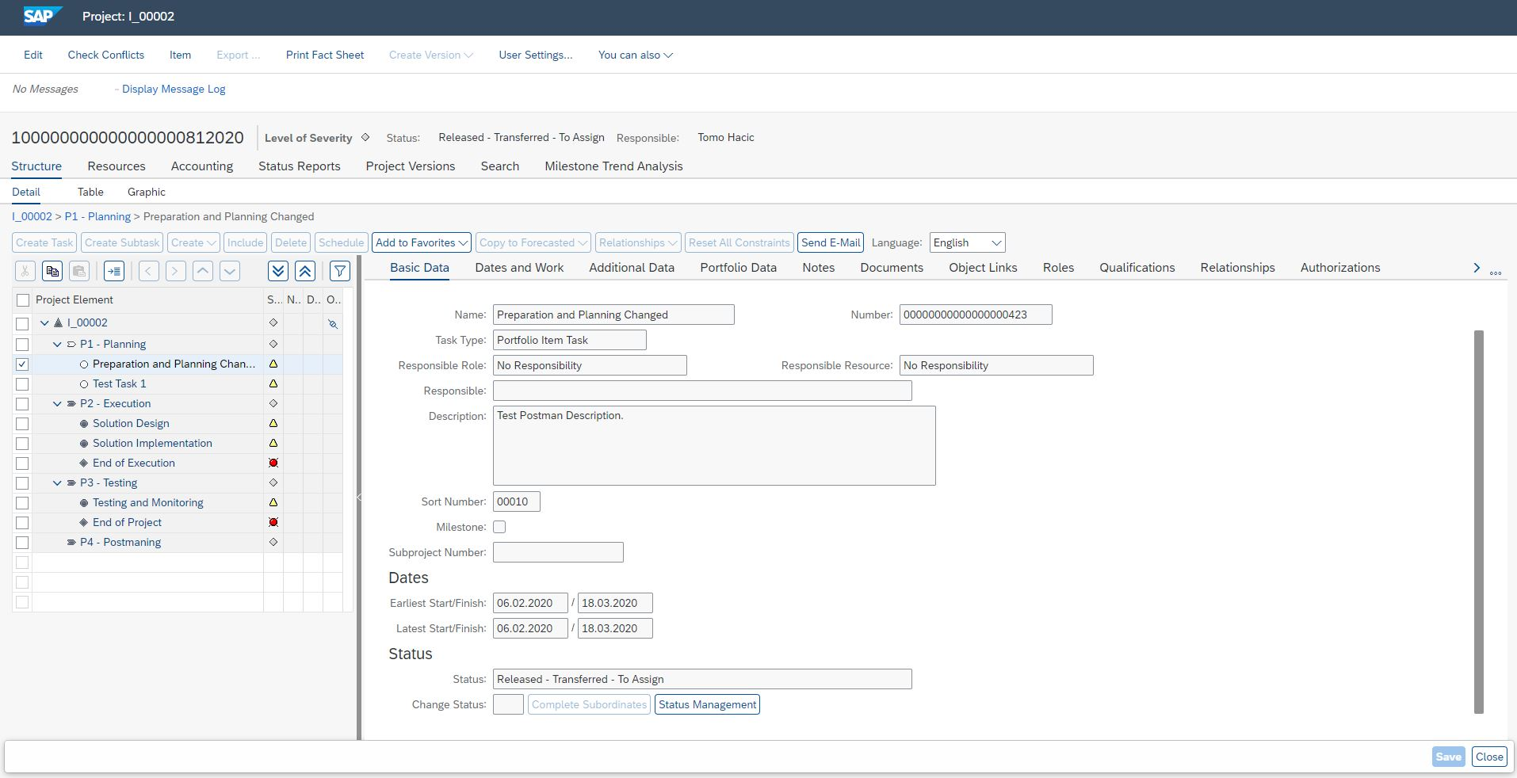


PPM Project– before Transfer (1, 2)
ID(Number) of a Task that we would like to transfer from SAP(PPM) to Oracle Primavera.
Task status must be set to „Released“, so it can be updated from Primavera to SAP direction.

Slide 6
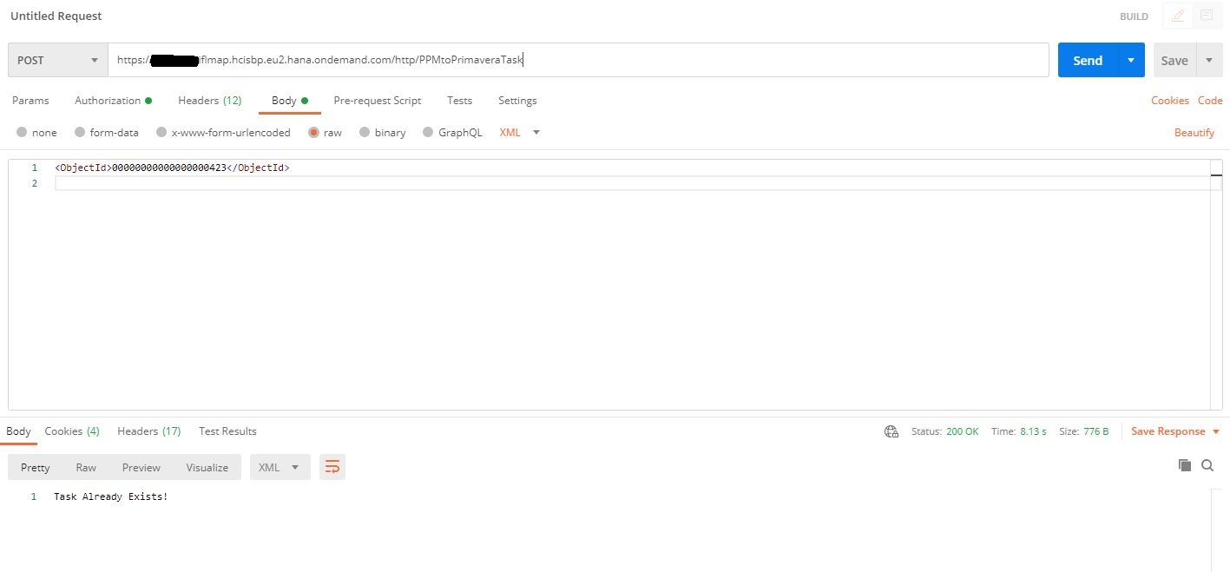

Post request through Postman (3.1)
Post request for initiation of “PPM to JIRA Task Worklogs Transfer” workflow.
https://<tenant>-iflmap.hcisbp.eu2.hana.ondemand.com/http/PPMtoPrimaveraTask
ID of a task that we want to transfer from S/4HANA to JIRA.
This info is visible in PPM project.
<ObjectId>
00000000000000000423 </ObjectId>

Slide 7
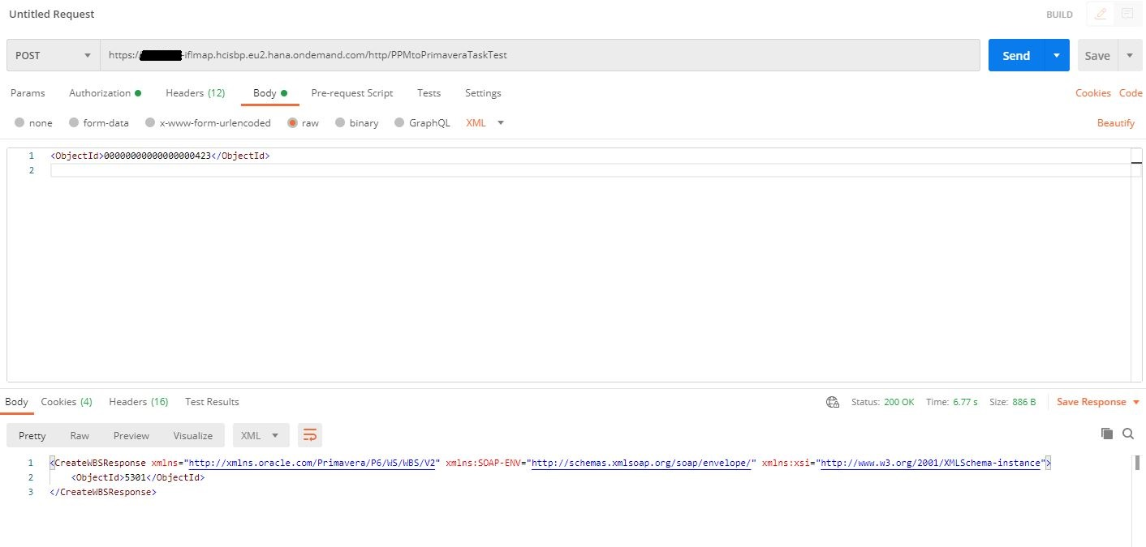
IFlow response message (3.1)
Expected response:
Identification key of a WBS created on Primavera.
Error response:
505 internal server error.
For more info check monitoring.
More info on next slide.

Slide 8
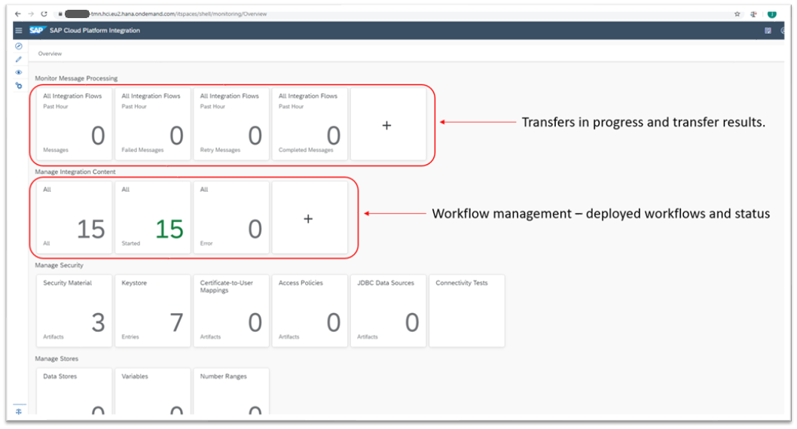
Operations flow - Monitorig

Slide 9
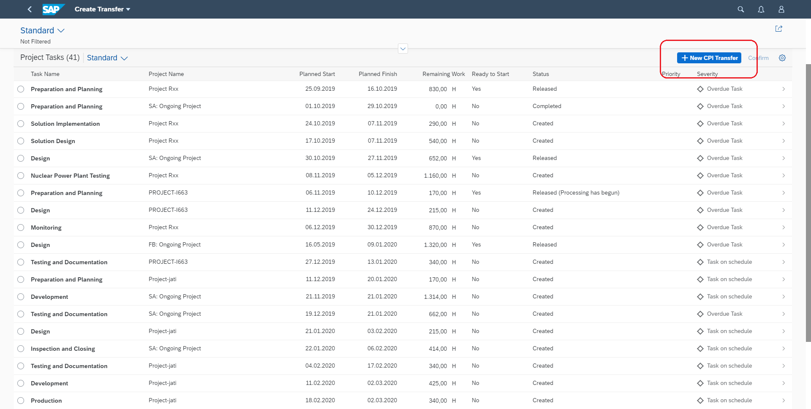
Commondo My Tasks extension (3.2)
Commondo has extend standard my tasks Fiori app to enable transfers trigger from user environment.

Slide 10
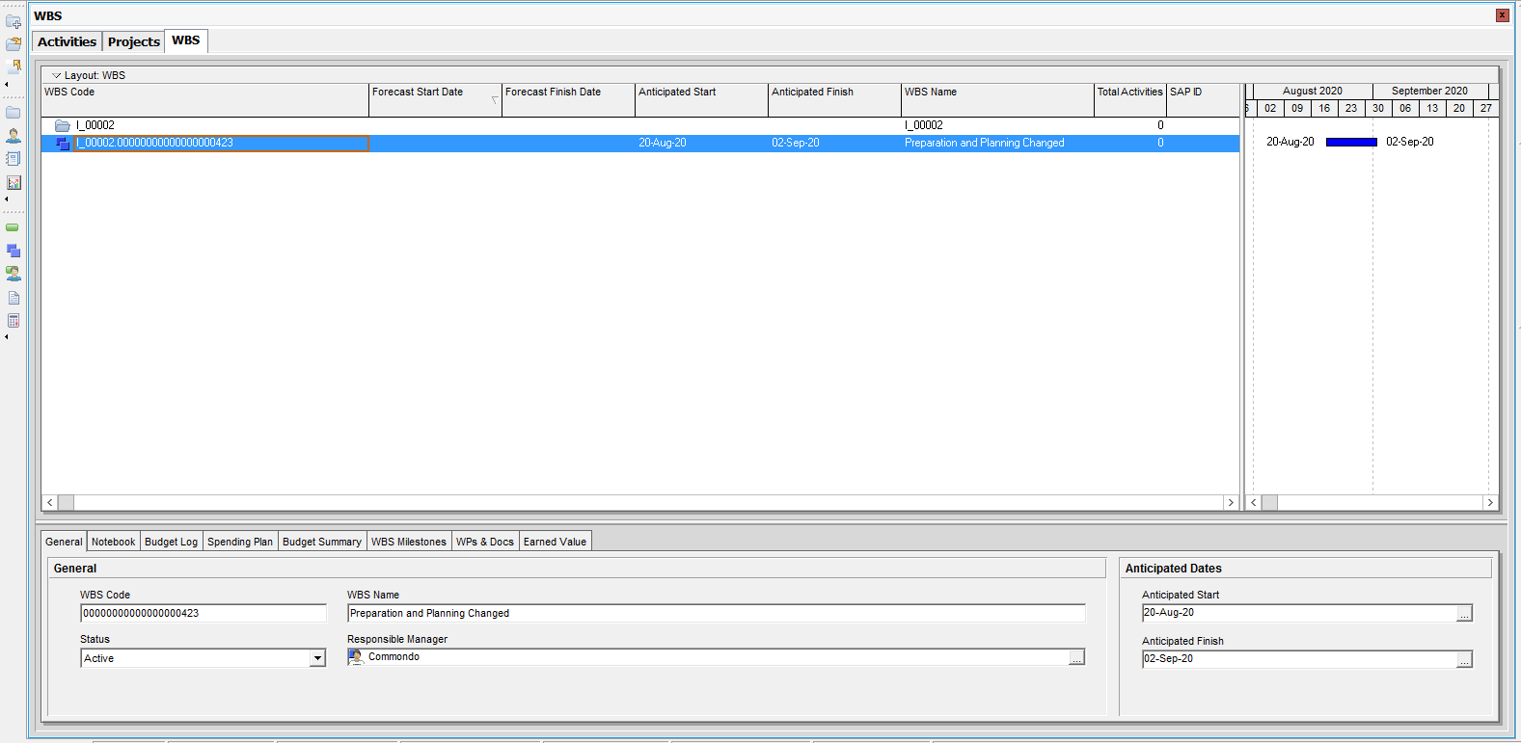
Primavera project – after Transfer (4)
New WBS on Primavera.
WBS is used as aggregation element for time logs from all Activities that are linked to him.

Slide 11
Oracle Primavera to SAP PPM

Slide 12
Primavera to PPM Task Worklogs Transfer
Updates project data from Primavera to SAP. The main goal of the workflow is to update planned and actual data, as well as some important scheduling data, aggregated on Oracle Primavera and transfer it to SAP PPM Task.
Steps needed to transfer task data from Oracle Primavera to PPM via “Primavera to PPM”:
  PPM project status needs to be “Released”.
  Primavera WBS created by PPM to Primavera transfer (this is required because of SAP metadata)
    Activities with logged time connected to this WBS
  Initiate transfer
    Using REST client (Postman in this document)
    Commondo My Tasks Fiori app extension
  Check new data in PPM project.

Slide 13
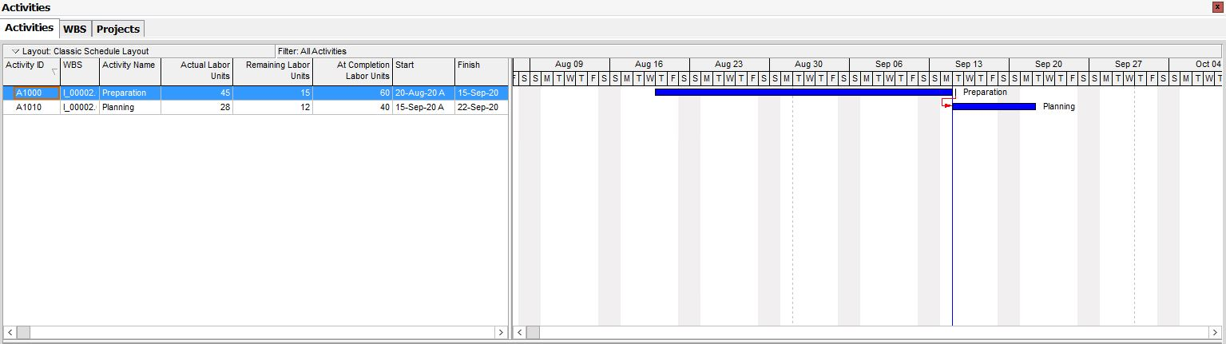
Primavera Project with new Activites
Here we can see two new Activities added to a “Preparation and Planning” WBS.
Logged, estimated and remaining time for a Preparation Activity.
Estimated: 60 hours
Confirmed time: 45 hours
Logged, estimated and remaining time for a Planning Activity.
Estimated: 40 hours
Confirmed time: 28 hours

Slide 14
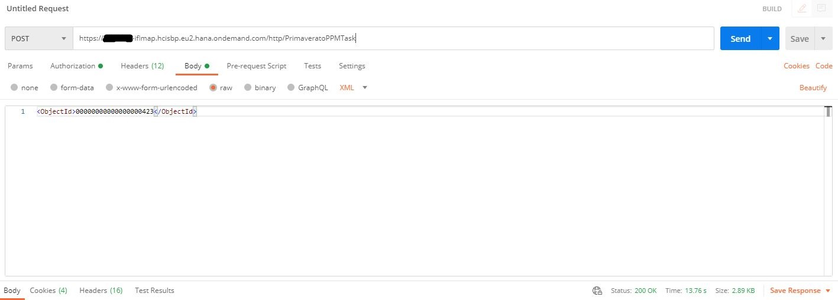
Post request through Postman
Post request for initiation of “Oracle Primavera to SAP PPM Task” workflow.
https://<tenant>-iflmap.hcisbp.eu2.hana.ondemand.com/http/PrimaveratoPPMTask
ID of a Task that we want to transfer from
Primavera to S/4HANA.
This info is visible in PPM project.
<ObjectId>00000000000000000423</ObjectId>

Slide 15
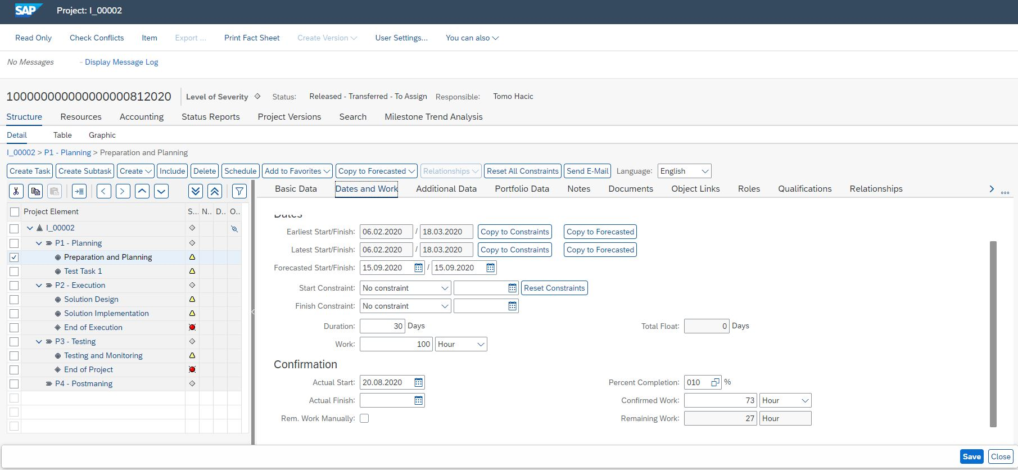
PPM Project - after Transfer
Planned work is changed. New value is 100h.
This value is accumulated from 2 Primavera Activites:
Preparation Activity
  At Completion Labor Units = 60 hours
Planning Activity
  At Completion Labor Units = 40 hours
Confirmed work is changed. New value is 73h.
This value is accumulated from 2 Primavera Activites:
Preparation Activity
  Actual Labor Units = 45 hours
Planning Activity
  Actual Labor Units = 28 hours
Remaining work can simply be checked as a substract of Planned and Confirmed Work

Slide 16
Thank you

